Slide 1
Exploring the Vibrational Spectrum of a hydroxy radical, QOOH
Coire Gavin-Hanner
Theory Group Meeting
8-16-21

Slide 2
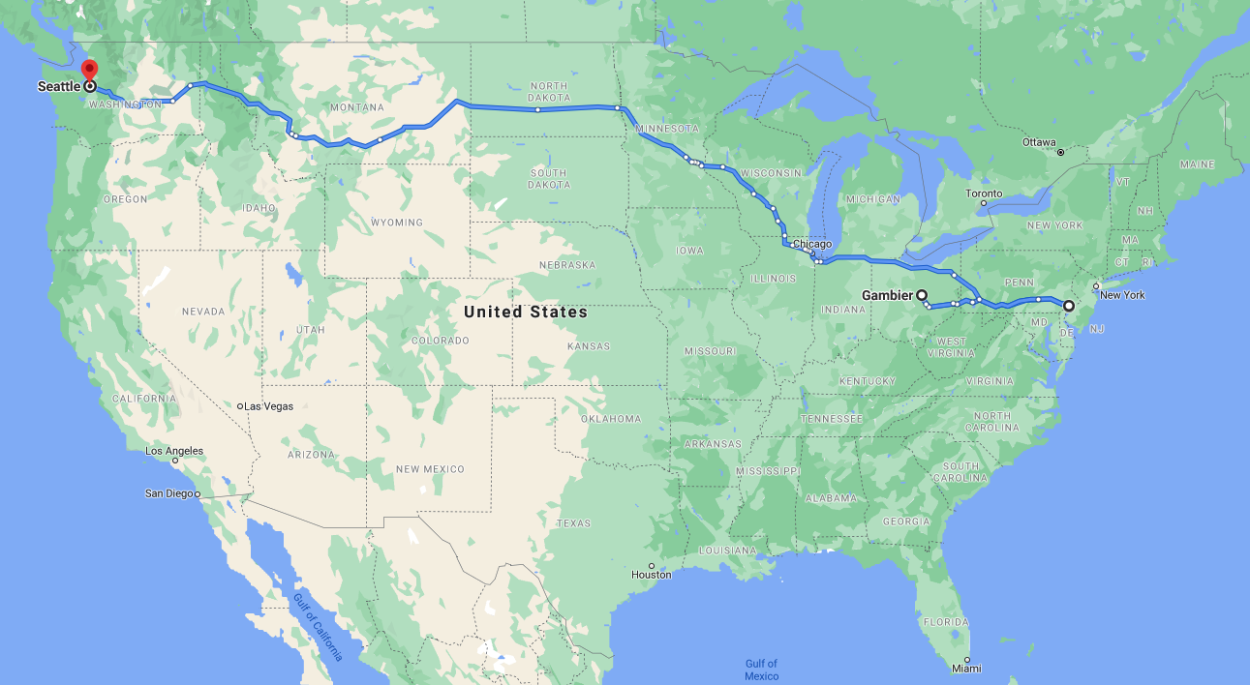

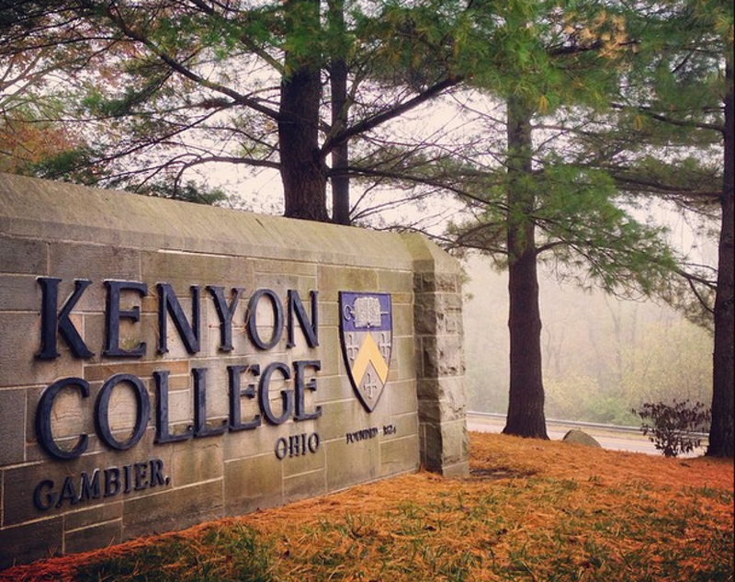
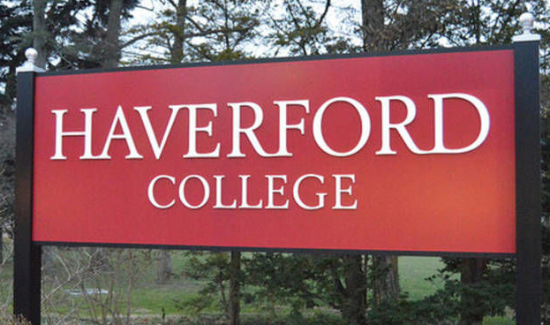
About me

Slide 3
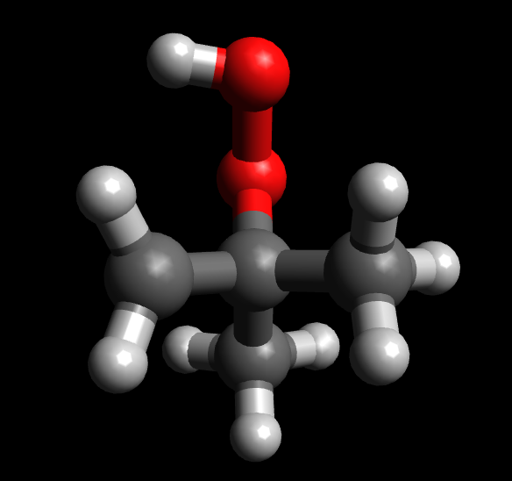
The System
QOOH
Notes:
Q is shorthand for group with radical
Tert-butyl peroxy with radical
Say it doesn’t blow up

Slide 4
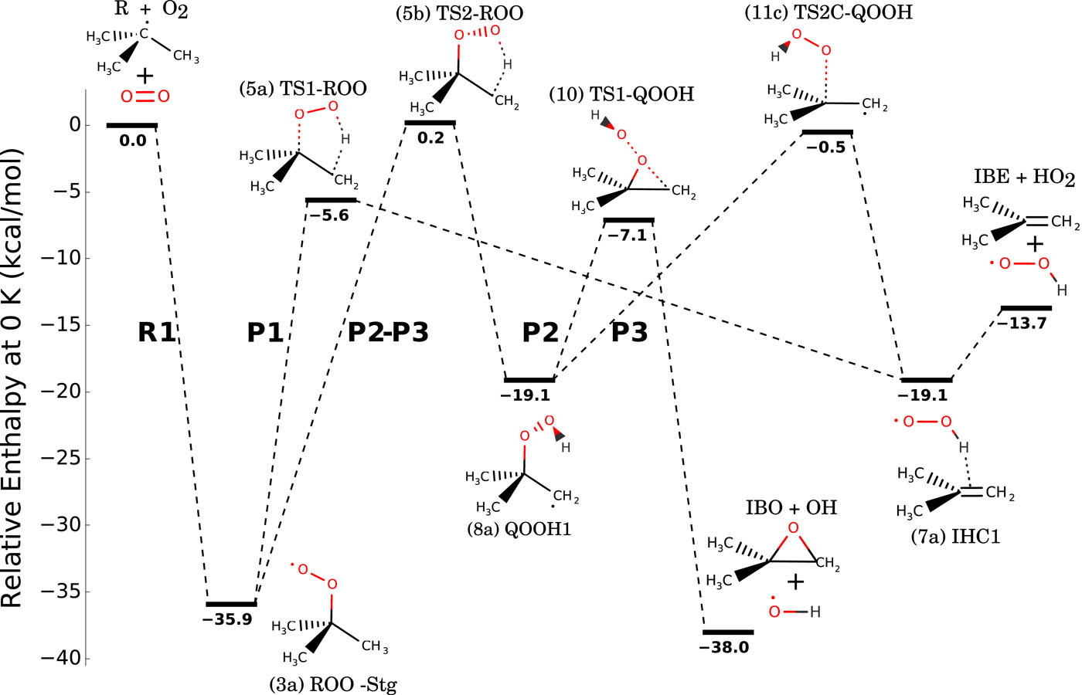
The Motivation
Are there applications/why do other people care?
Kevin B. Moore III; Justin M. Turney; Henry F. Schaefer III; J. Chem. Phys. 146, 194304 (2017)
Notes:
Leads to reactive hydroxy radicals
Applications in atmospheric and combustion chemistry
A low barrier to isomerization leads to a lot of interesting chemistry

Slide 5
The Motivation
Why do we care as theorists?
QOOH1
QOOH2

Slide 6
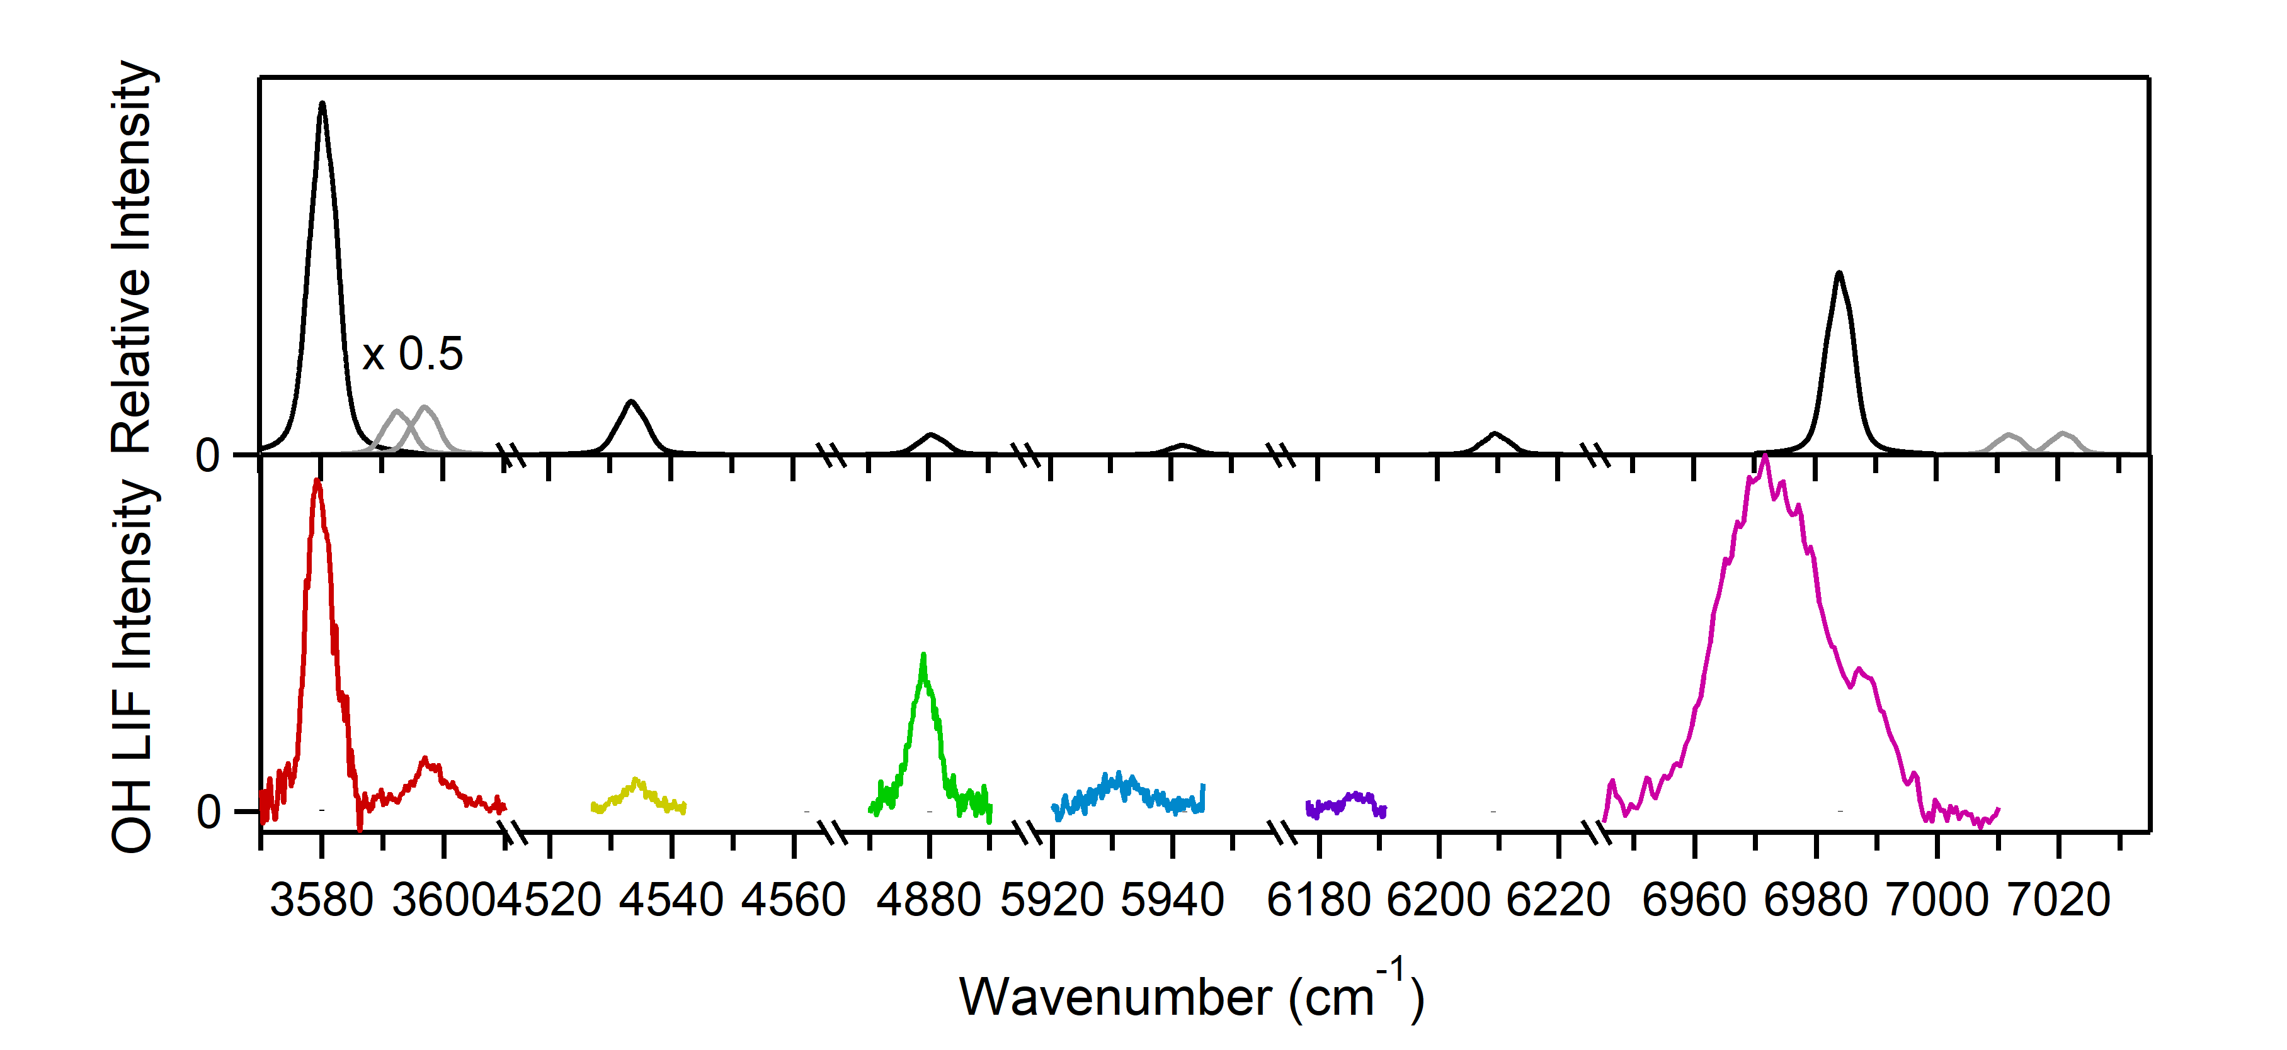
The Experiment
Lester Group, UPenn

Slide 7
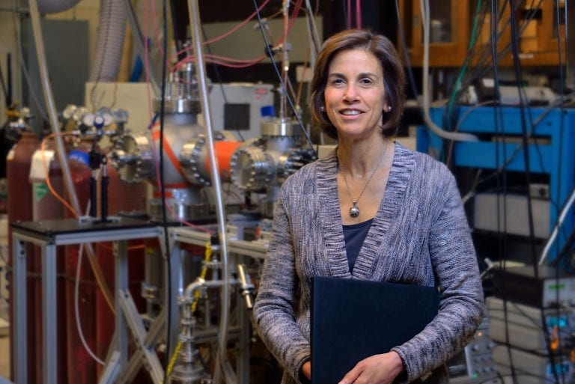
Group Strategy
Experiment
VPT2
Reduced Dimensional

Slide 8
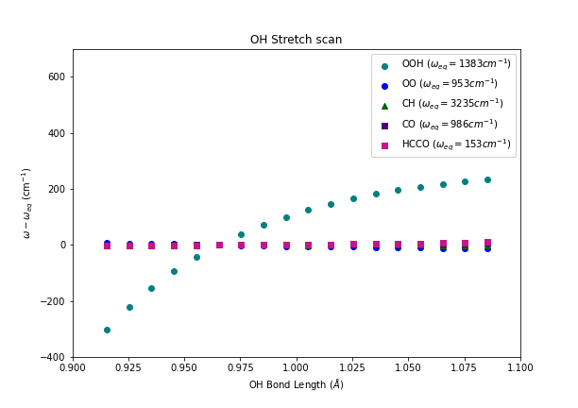
Missed Couplings?
Local Mode Analysis

Slide 9
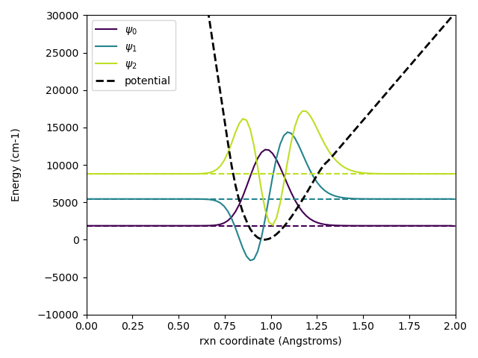
Vibrational Wavefunctions
Discrete Variable Representation (DVR)
Colbert and Miller J. Chem. Phys. 96, 1982 (1992); https://doi.org/10.1063/1.462100
Notes:
DVR basis functions, Colbert miller 1991

Slide 10
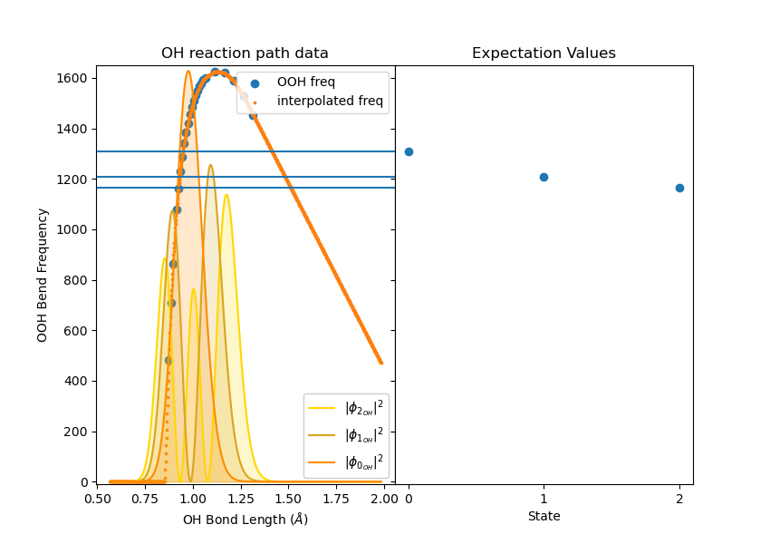
Corrections to the Vibrational Energy

Slide 11
Can the Chemistry Explain the Spectrum?

Slide 12
Can the Chemistry Explain the Spectrum?
QOOH1
QOOH2
Shift from experiment
13 cm-1
4 cm-1

Slide 13
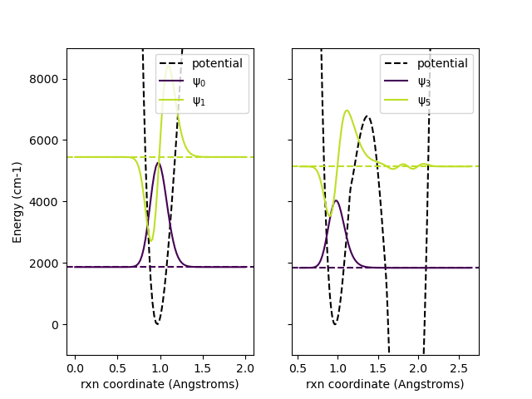
Can the Chemistry Explain the Spectrum?

Slide 14
Conclusions
There are coupling terms that need to be added to the reduced-dimensional model
Some of the spectral features can be explained by the chemistry

Slide 15

Acknowledgments
Anne McCoy
McCoy Group
Xantheas Group

